Slide 1








Java Memory Management
Proudly recognized by

Slide 2
Introduction to Java Memory Management
Java Memory Model Overview
Stack vs Heap Memory
Heap Memory Structure
Garbage Collection
String Pools
JVM Tuning for Performance
Tools for Monitoring Memory Usage
Best Practices
Agenda

Slide 3
Introduction to Java Memory Management
Memory Management
Memory Allocation: Allocating memory for variables, objects and data structures during program execution
Memory Deallocation: Releasing memory when no longer needed
Memory leaks - Occurs when memory that is no longer needed is not released, leading to increased memory consumption over time.
JVM automatically does memory management through garbage collection, but it still requires optimization for performance.

Slide 4
Bonus - OS Memory Management
Process Creation and Memory Allocation
When a program is executed, the OS creates a process and allocates memory for it.
The OS provides virtual memory for the process, which gives the illusion of a large, continuous block of memory, even though the physical memory may be fragmented.
Memory Segments for Each Process The OS divides memory for each process into different regions:
Text Segment: Stores the executable code of the program.
Data Segment: Stores global and static variables.
Heap: Used for dynamic memory allocation (like objects in Java).
Stack: Stores function calls, return addresses, and local variables.
Memory Request and Allocation
When a process needs more memory (for example, when creating new objects or allocating large arrays), it sends a request to the OS.
The OS allocates more memory from the system’s RAM or swaps data to virtual memory (on disk) to accommodate this request.
How the OS Communicates with Processes
The OS manages the process’s memory and keeps track of its usage. If the process exceeds its allocated memory, the OS may:
Swap data to disk (paging), if physical memory (RAM) is full.
Allocate additional memory if the system has free resources.
Processes cannot directly access memory allocated to other processes, and the OS ensures isolation and protection between them.

Slide 5
Connect to Java Memory Management
In Java, the JVM requests memory from the OS for the heap, stack, and other parts. The JVM is responsible for managing dynamic memory allocation (like objects) and performs garbage collection to clean up memory automatically. JVM can request more memory from OS, if needed and configured to do so.

Slide 6
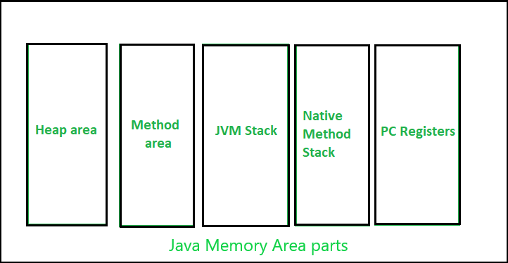
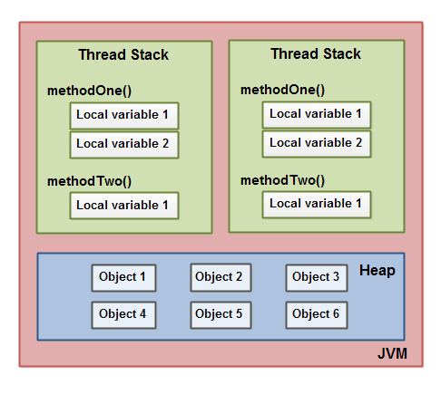
Java Memory Model Overview
Heap Area : Used for dynamic memory allocation. Contains objects and arrays, and is shared across all threads.
Stack: Used for storing local variables, method frames, and control flow. Each thread has its own stack.
Method Area: Stores class-level information such as bytecode, method data, and static variables.
Program Counter (PC) Register: Points to the current executing instruction.
Native Method Stack: Holds native method calls (e.g., interacting with system-level code outside Java).

Slide 7
Stack vs Heap
Stack
Heap
Local Variables: When a method is invoked, local variables (including method parameters) are pushed onto the stack. These variables are automatically cleaned up (popped off) when the method finishes executing.
Memory Allocation: Stack memory is allocated in blocks and managed automatically. Each time a method is called, a new stack frame is created. When the method finishes execution, its stack frame is destroyed.
Scope and Lifetime: The lifetime of variables in the stack is limited to the scope of the method or block they are declared in. When the method ends, all variables are removed from the stack automatically.
Fast Allocation: The stack is managed by the JVM and OS in a way that allows quick allocation and deallocation of memory. Since the stack uses the LIFO principle, it is extremely fast for allocating and freeing memory.
Size: The size of the stack is generally small (compared to the heap) and can be configured depending on the platform. It is usually limited and can cause a StackOverflowError if you exceed it, for example, with a deep recursive method call.
Dynamic Memory Allocation: Objects and arrays are created using new in Java, and the memory for these is allocated on the heap. For example, new int[10] or new MyClass() both allocate memory in the heap.
Garbage Collection: Heap memory is managed by the JVM’s garbage collector (GC), which automatically frees memory that is no longer in use (i.e., objects that are no longer referenced).
Memory Allocation: Unlike the stack, memory allocation in the heap is slower because it involves finding available space in a large pool of memory. However, the heap can grow dynamically to accommodate more objects if required (limited by system resources).
Lifetime: The lifetime of an object in the heap is not tied to the scope of a method or block. It exists as long as there are references to it. Once there are no references to an object, it becomes eligible for garbage collection.
Size: The heap is typically larger than the stack and can be configured to a larger size depending on the system’s available memory and JVM settings. It is usually where most of the program's data resides.

Slide 8
Stack vs Heap - Stack
public class Main {
public static void main(String[] args) {
int value = 7;
value = calculate(value);
}
public static int calculate(int data) {
int tempValue = data + 3;
int newValue = tempValue * 2;
return newValue;
}
}
newValue = 20
tempValue = 10
data = 7
value = 7
args = Empty Array
Stack

Slide 9
Stack vs Heap - Stack & Heap Together
int age = 22;
String name = “TTN”;
Stack
Heap
String
name
Hello
age = 22

Slide 10
Stack vs Heap - Sharing Data
data
public class Main {
public static void main(String[] args) {
List<String> myList = new ArrayList<String>();
myList.add("CK");
myList.add("CloudKeeper");
myList.add("Intelligrape");
printList(myList);
}
public static void printList(List<String> data) {
System.out.println(data);
}
}
myList
List
String
Intelligrape
0
1
2
String
String
Cloudkeeper
CK

Slide 11
Java vs Heap - Summary
Objects are stored in the heap ___________________
Object references are stored in the ________________
Local variables are stored in the ____________
Each Thread in Java has their own _________, _______ is shared for all threads.
If there is no memory left in the stack, JVM throws ______________. In case of __________, it is OutOfMemoryError

Slide 12
Stack vs Heap - Exercise
** create java stack and memory diagram
** Guess the output
public class Main {
public static void main(String args[]) {
Main main = new Main();
main.start();
}
public void start() {
String last = "Z";
Container container = new Container();
container.setInitial("C");
another(container,last);
System.out.print(container.getInitial());
}
public void another(Container initialHolder, String newInitial) {
newInitial.toLowerCase();
initialHolder.setInitial("B");
Container initial2 = new Container();
initialHolder=initial2;
System.out.print(initialHolder.getInitial());
System.out.print(newInitial);
}
}
public class Container {
private String initial = "A";
public String getInitial() {
return initial;
}
public void setInitial(String initial) {
this.initial = initial;
}
}

Slide 13
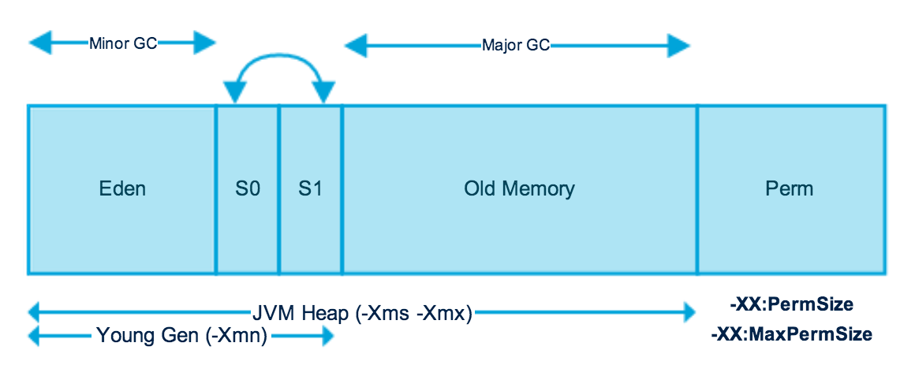
Heap Memory Structure
Young Generation
Eden Space: Where new objects are allocated.
Survivor Spaces: Two survivor spaces (S0 and S1) store objects that survive garbage collection in the Eden space. After multiple GC cycles, objects are promoted to the Old Generation.
Old Generation
Stores objects that have survived multiple garbage collection cycles and are considered long-lived.
Metaspace
In Java 8+, Metaspace replaced PermGen.
Metaspace is stored in native memory (outside the heap) and no longer has a fixed size limit.
Stores JVM-level information, like class definitions, method data, and static variables.
While Metaspace is outside the heap, it still uses garbage collection to reclaim memory. This occurs when classes are unloaded, and their associated metadata is cleaned up.

Slide 14
Garbage Collection
Garbage Collector is a thread running in the background that looks into all the objects in the memory and find out objects that are not referenced by any part of the program. All these unreferenced objects are deleted and space is reclaimed for allocation to other objects.
Steps in GC : An object is eligible for GC if it is not reachable from any live thread or static field.
Marking: The first step is marking all objects that are still in use (reachable). These objects are still referenced by the application, meaning they are not eligible for garbage collection.
Normal Collection: After marking, the garbage collector will start to collect all the unreachable objects, reclaiming their memory space. These objects are cleaned up because they no longer have any references pointing to them.
Reclaiming Space: After collecting the garbage objects, the heap is compacted or reorganized. This step is necessary to ensure the heap doesn’t have fragmented free space, which can lead to inefficient memory usage and slow performance.
Garbage Collection Phases in Generational Heap
Minor GC: Occurs in the Young Generation. It typically happens when the Eden space is full. Objects that survive the collection in Eden are moved to one of the Survivor Spaces.
Major GC (or Full GC): Occurs in the Old Generation. This happens when the Old Generation is full or when a Minor GC doesn't free enough space.
Stop-the-World Event
Stop-the-World refers to a phase during garbage collection where all application threads are paused to allow the garbage collector to do its job. This pause is necessary because the garbage collector must have exclusive access to memory while reclaiming space.
In most garbage collection strategies, Stop-the-World events occur during major garbage collection (like Full GC or when promoting objects to the Old Generation).

Slide 15
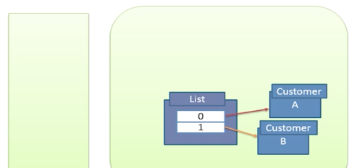

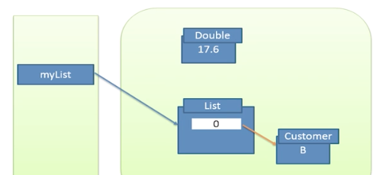
Garbage Collection - Eligibility

Slide 16
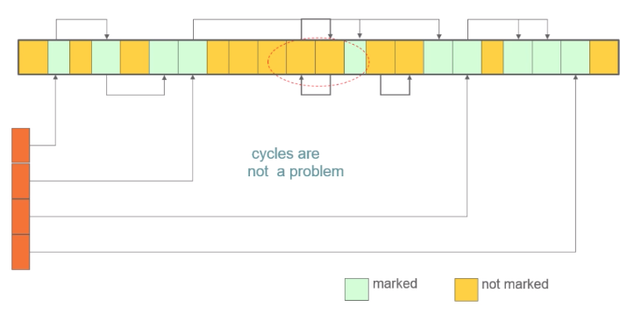
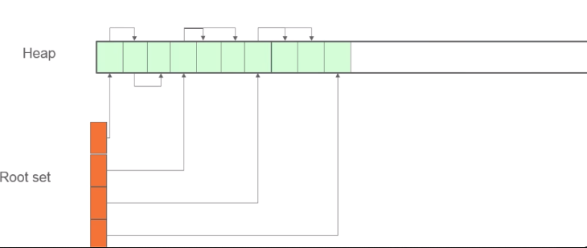
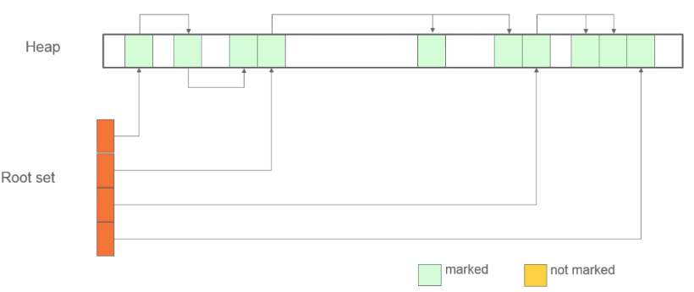
Garbage Collection - Phases
Marking Phase
Compaction Phase
Sweep Phase

Slide 17
Garbage Collector Types
Serial GC : Uses the simple mark-sweep-compact approach for young and old generations garbage collection. Good for application with low memory footprint.
Parallel GC : Same as serial GC, except it spawns N thread for young generation garbage collection. Parallel GC uses a single thread for Old Generation garbage collection.
Parallel Old GC: This is same as Parallel GC except that it uses multiple threads for both Young Generation and Old Generation garbage collection.
Concurrent Mark Sweep (CMS) Collector: CMS collector tries to minimize the pauses due to garbage collection by doing most of the garbage collection work concurrently with the application threads.CMS collector on the young generation uses the same algorithm as that of the parallel collector.
G1 Garbage Collector: No concept of young and old generation in this collector. It divides the heap space into multiple equal-sized heap regions. When a garbage collection is invoked, it first collects the region with lesser live data
ZGC and Shenandoah

Slide 18
Garbage Collection Types
Serial GC : Uses the simple mark-sweep-compact approach for young and old generations garbage collection. Good for application with low memory footprint.
Parallel GC : Same as serial GC, except it spawns N thread for young generation garbage collection. Parallel GC uses a single thread for Old Generation garbage collection.
Parallel Old GC: This is same as Parallel GC except that it uses multiple threads for both Young Generation and Old Generation garbage collection.
Concurrent Mark Sweep (CMS) Collector: CMS collector tries to minimize the pauses due to garbage collection by doing most of the garbage collection work concurrently with the application threads.CMS collector on the young generation uses the same algorithm as that of the parallel collector.
G1 Garbage Collector: No concept of young and old generation in this collector. It divides the heap space into multiple equal-sized heap regions. When a garbage collection is invoked, it first collects the region with lesser live data
ZGC ….

Slide 19
String Pools
In the context of Java memory management, the String Pool is stored in the Non-Heap Memory area, specifically in the Metaspace
The String Pool is a special area where Java stores string literals (i.e., string constants) to optimize memory usage
Strings are immutable in Java, which means once a string is created, it cannot be changed.
To improve efficiency and reduce memory usage, Java ensures that identical string literals are stored only once, making the string pool a very important part of the JVM memory structure.
String Pool Working
String Interning:When you create a string using a string literal like "Hello", Java checks if that string already exists in the String Pool. If the string is already in the pool, Java reuses the reference to that string.If the string is not present in the pool, Java adds it to the pool and then uses that reference
Memory Optimization: This mechanism helps in memory optimization since duplicate string objects are avoided.
Manual Interning: You can also manually add strings to the pool by using the intern() method. This method ensures that a string is added to the pool and returns a reference to the string in the pool.
String str1 = new String("Hello");
String str2 = str1.intern(); // str2 will refer to the string "Hello" from the pool

Slide 20
JVM Tuning for Performance
Tuning Heap Size:
Too small of a heap can lead to frequent GC, while too large a heap can cause longer GC pauses.
Initial Heap Size (-Xms): This parameter sets the initial size of the heap.
Maximum Heap Size (-Xmx): This sets the maximum size of the heap.
Additionally you can tune the size of old and new generation.
Garbage Collection Tuning
GC Type: You can set the appropriate GC as per your requirement. e.g. Serial GC (-XX:+UseSerialGC), CMS (Concurrent Mark-Sweep) GC (-XX:+UseConcMarkSweepGC), G1 GC (-XX:+UseG1GC)
GC Threads: Adjust the number of threads the gc uses to process GC work in multi core systems.. E.g. -XX:ParallelGCThreads flag sets the number of threads used by the Parallel GC.
GC Log File: Enabling GC logging helps in analyzing the behavior of the garbage collector and identifying performance bottlenecks. E.g. Xloggc:<file-path>: Enables logging of GC activities.
Thread Stack Size: The thread stack size defines the amount of memory allocated for each thread’s stack. Use -Xss flag to set the stack size
Metaspace Tuning:
-XX:MetaspaceSize: Sets the initial size of the Metaspace.
-XX:MaxMetaspaceSize: Sets the maximum size of the Metaspace. If not specified, it can grow dynamically.

Slide 21
Tools for Monitoring Memory Usage
JConsole
Powerful, graphical monitoring tool that comes with the JDK (Java Development Kit)
Allows you to monitor various aspects of a Java application, such as memory usage, garbage collection, threads, and CPU usage, in real-time
Jmap - Java Memory Map Tool
command-line tool provided with the JDK that can be used to obtain memory-related information about a running Java process.
provides a snapshot of the heap memory, the heap dump, and statistics related to memory usage
jmap -dump:file=test.jmap,format=b <pid>
To make a Java application dump the heap on an OutOfMemoryError, you can use specific JVM options to enable heap dumps whenever the application runs out of memory. This can be very useful for diagnosing memory-related issues, such as memory leaks. JVM Arguments : -XX:+HeapDumpOnOutOfMemoryError -XX:HeapDumpPath=<path_to_heap_dump>
Eclipse MAT (Memory Analyzer Tool)
open-source Java heap analysis tool designed to help developers detect memory leaks, analyze memory usage, and optimize the performance of Java applications.

Slide 22
Best Practices
Minimize Object Creation
Avoid unnecessary object creation: Instead of creating new objects in loops or frequently called methods, consider using existing instances where possible
Use StringBuilder instead of String concatenation: When concatenating strings inside loops, StringBuilder is more memory-efficient than repeatedly using + with String (which creates new string objects every time).
Use Primitive Types When Possible: Prefer primitives (int, double, float) over wrapper classes like Integer, Double, etc., unless you need them to be nullable or to support generics.
Optimize Garbage Collection (GC)
Tune heap sizes
Choose the right GC:
Monitor and Analyze Memory Usage
Clean Up Resources : Close resources like I/O streams, database connections, and sockets when they are no longer needed. Use try-with-resources or finally blocks to ensure resources are always released.
Avoid Using Large Collections:
Large collections (such as big lists or maps) can consume a lot of memory. Only load necessary data into memory.
Use paging techniques or streaming APIs (like Streams in Java 8) to process data in smaller chunks instead of loading everything into memory at once.
Profiling and Heap Dumps: If your application is running into memory issues, take a heap dump during the error and analyze it using tools like Eclipse MAT or JConsole.

Slide 23
Thank You

